Slide 1

LangChain: The RAG Framework
Building Intelligent Document Assistants with Retrieval-Augmented Generation

Slide 2

Modern AI Orchestration
Why static LLMs are not enough for enterprise documents

Slide 3

What is LangChain?
A Framework for LLMs
Bridging Context & Intelligence
LangChain is an open-source framework designed to simplify the creation of applications using large language models (LLMs) by providing a modular architecture.
It allows developers to "chain" different components like data loaders, vector databases, and prompt templates to build context-aware applications.

Slide 4

The RAG Concept
Retrieval-Augmented Generation (RAG) overcomes the limitations of LLM knowledge cut-offs by fetching relevant data before generating a response.
•
Reduces hallucinations by using ground truth.
•
Ensures responses are based strictly on private data.
•
Enables real-time knowledge updates.

Slide 5






The Development Pipeline
1. Ingestion
2. Chunking
3. Vector Storage
Extracting raw text from PDF and DOCX files using libraries like PyPDF2 and Python-Docx.
Splitting text into overlapping segments to maintain context and fit within model limits.
Converting text into embeddings and storing them in ChromaDB for high-speed retrieval.

Slide 6
Optimizing Retrieval
500
The Power of Granularity
By using a chunk size of 500 characters with a 100-character overlap, the system ensures that relevant snippets are easily identifiable by the vector database without losing semantic continuity.
Standard Chunk Size

Slide 7
The Technical Stack
HuggingFace Embeddings: Utilizing e5-large-v2 for dense vector representation.
ChromaDB: An open-source vector store for efficient semantic search.
ChatOpenAI (GPT-4o-mini): The reasoning engine processed via OpenRouter.

Slide 8
Component Breakdown
Layer | Technology | Role
Frontend | Streamlit | User interface and session state management
Framework | LangChain | Orchestration of retrieval and QA chains
Intelligence | GPT-4o-mini | Final answer synthesis based on context
Storage | Chroma | Local vector database for fast similarity search

Slide 9
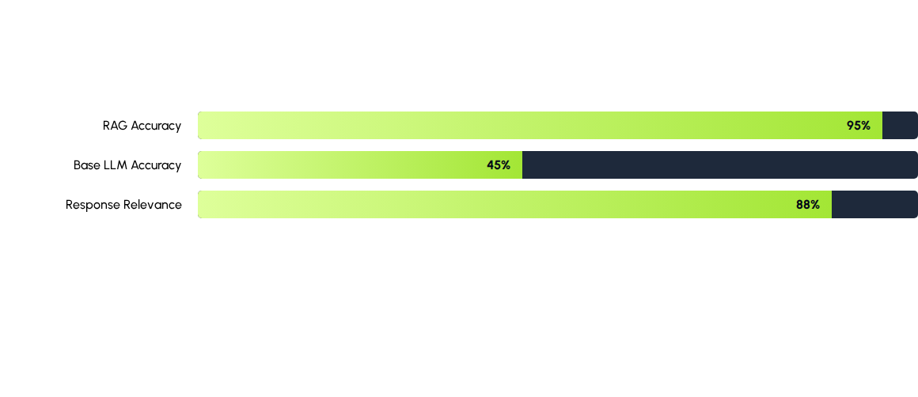
Performance Advantage
RAG significantly reduces hallucinations by grounding responses in specific document context.

Slide 10
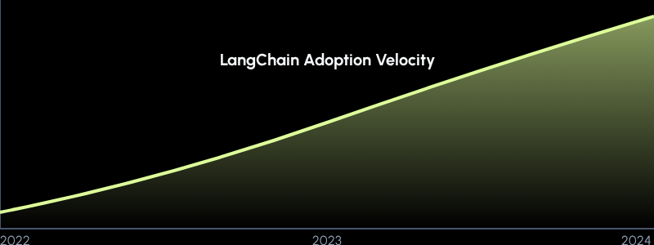
Framework Growth Trends

Slide 11

Future-Proofing Intelligence
LangChain is transforming how businesses interact with their own data, moving from simple search to conversational insight.

